Slide 1
Introductory General Chemistry
Chemistry 3A
Experiment 9a
Solutions & Dilutions
Mitch Halloran

Slide 2
Introduction
Making concentrated (“stock”) solutions and then diluting them to make less concentrated solutions—dilutions—is one of the most common and important things done in the chemistry laboratory
Being able to make calculations related to preparing solutions and making dilutions of the solutions is the most important thing

Slide 3
Background
Did you know the amount of salt dissolved in natural waters can have concentrations that qualify them as fresh, brackish, briny or the “normal saline” level in blood?
Brines are
solutions that vary from saturated to a bit less than saturated
Used to preserve food by pickling it
Two solutions of sodium chloride (NaCl) will be prepared
Solution 1
This is a “stock concentrated” solution in which solid NaCl is weighed out and dissolved
These solutions are usually stored long-term
Solution 2
This a “working” solution made as a dilution from the stock solution
These solutions are made for temporary use and discarded
These solutions should be made at the right concentration and volume with attention to minimizing waste

Slide 4

Concepts
$Molarity \left(M\right)=\frac{moles \left(mol\right) solute}{liters (L) solution}$
$Mass Percent \left(\frac{m}{m}\%\right)=\frac{mass (g) solute}{100 g solution}= \frac{mass solute}{mass solution}×100\%$
$Molality \left(m\right)=\frac{mol solute}{kg solvent}$
$Mass Volume Percent \left(\frac{m}{V}\%\right)=\frac{mass (g) solute}{100 mL solution}=\frac{mass (g) solute}{mL solution}×100\%$
$Volume Percent \left(\frac{V}{V}\%\right)=\frac{volume (mL) solute}{100 mL solution}=\frac{volume solute}{volume solution}×100\%$
$Solution Density=\frac{grams solution}{milliliters solution}$

Slide 5
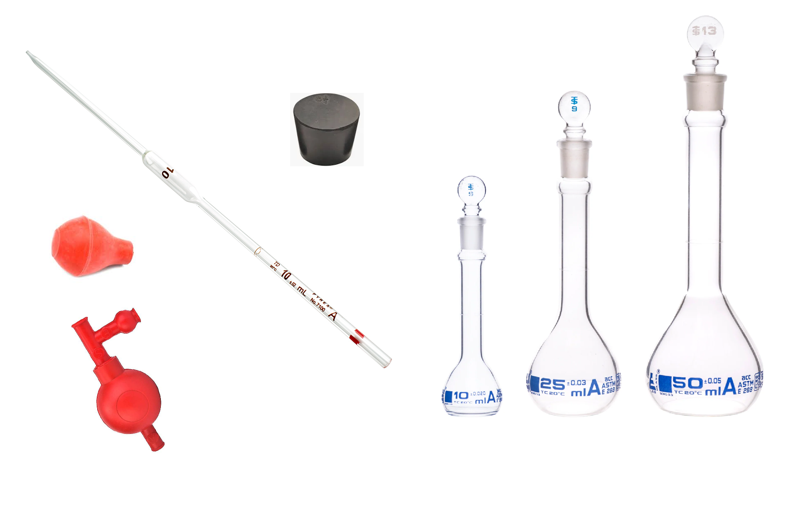
Equipment You Will Use

Slide 6
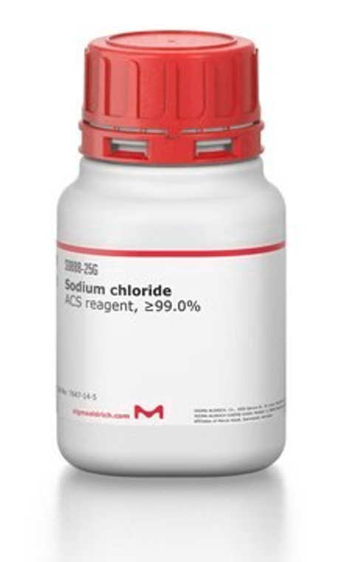
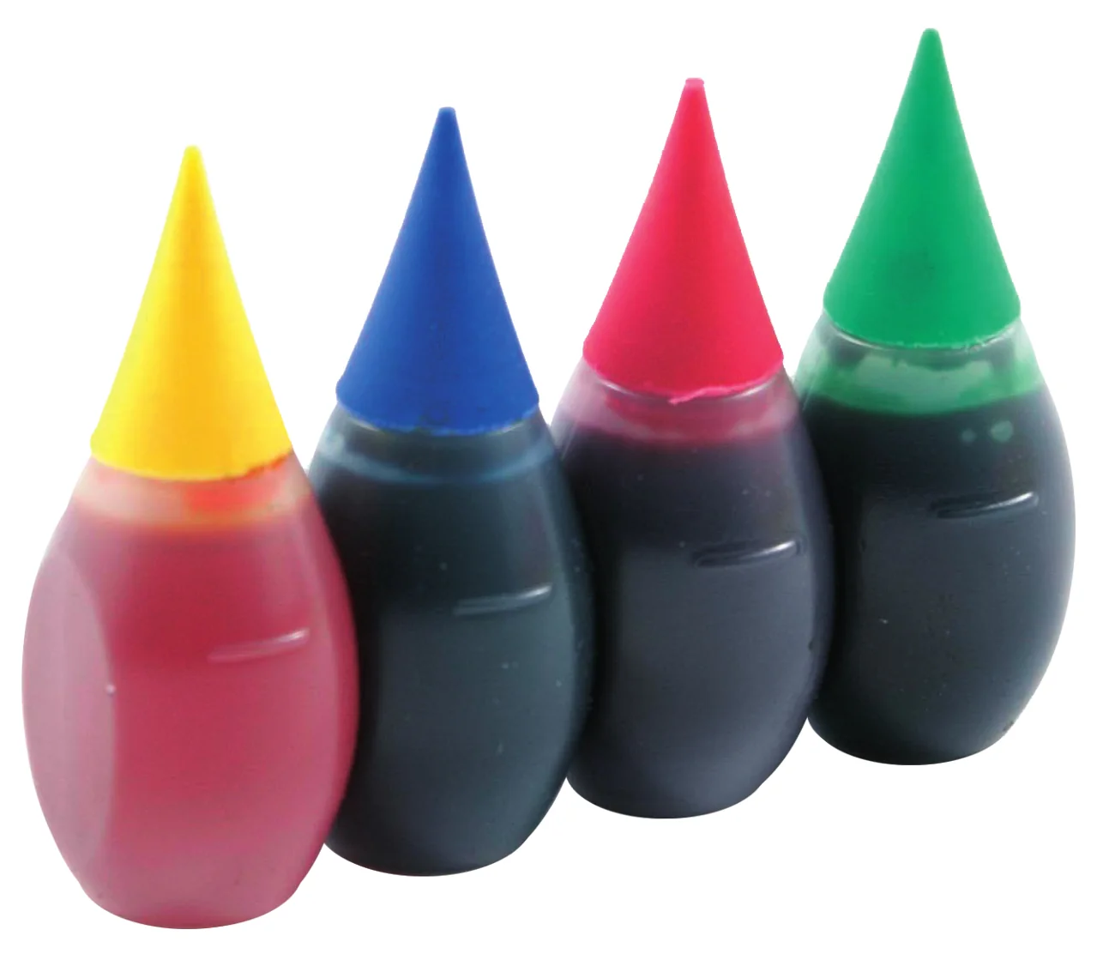
Consumables

Slide 7
Procedure
Solution A
Use a Sharpie (permanent marker) to write “A” on 50 mL volumetric flask
Record mass of the empty flask
Measure out 4.5-6.0 g NaCl on glassine paper and deliver to 50 mL flask
Record mass of flask containing the NaCl
Fill flask with DI water to about halfway, add 1 gtt food coloring, swirl to dissolve most or all of salt
Place the stopper, fill to volume mark with DI water. Mix by inversion, inverting about 15 times
Fill to mark again noting meniscus. Record mass of solution

Slide 8
Procedure
Solution B
Use a Sharpie (permanent marker) to write “B” on 25 mL volumetric flask
Record mass of the empty flask
With 10 ml pipet, transfer 10.00 mL of “A” into flask for “B”
Fill flask with DI water to the line. Place stopper and mix by inversion at least 15 times
Fill to mark again noting meniscus. Record mass of solution

Slide 9
Clean Up
Saline solutions are safely discarded in the sink
Flush the volumetric pipet with DI water (collect in beaker, then dump beaker wash)
Rinse the volumetric flasks a couple of time with DI water from its tap. If possible, place flasks upside down on drying racks near sinks
If you used Sharpie on glass, use a very small amount of acetone to wash it off (paper towel helps)

Slide 10
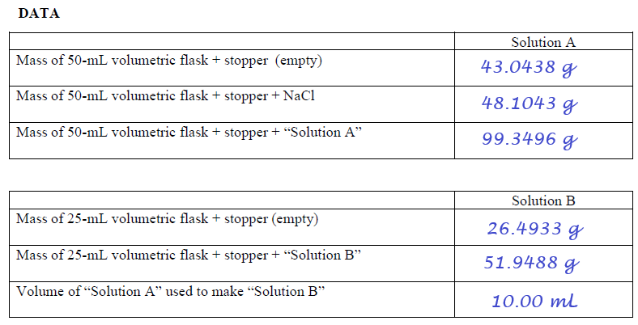
Example Data Analysis
Make sure that you use the significant digits of for the volumes in the flasks and pipets shown on p 97: 10.00 mL, 25.00 mL, 50.00 mL

Slide 11
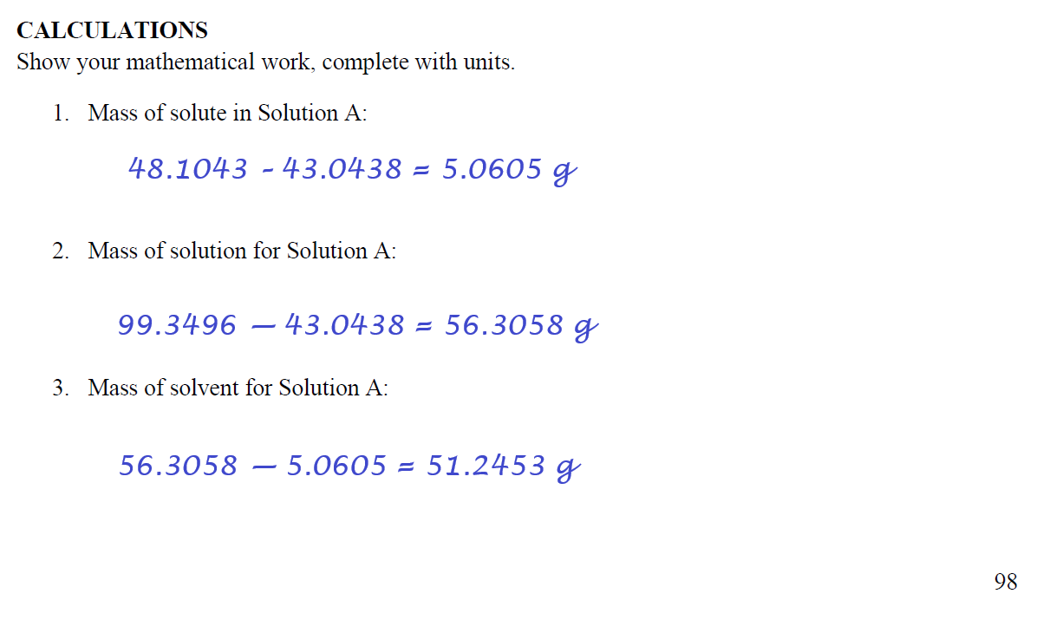
Example Data Analysis

Slide 12
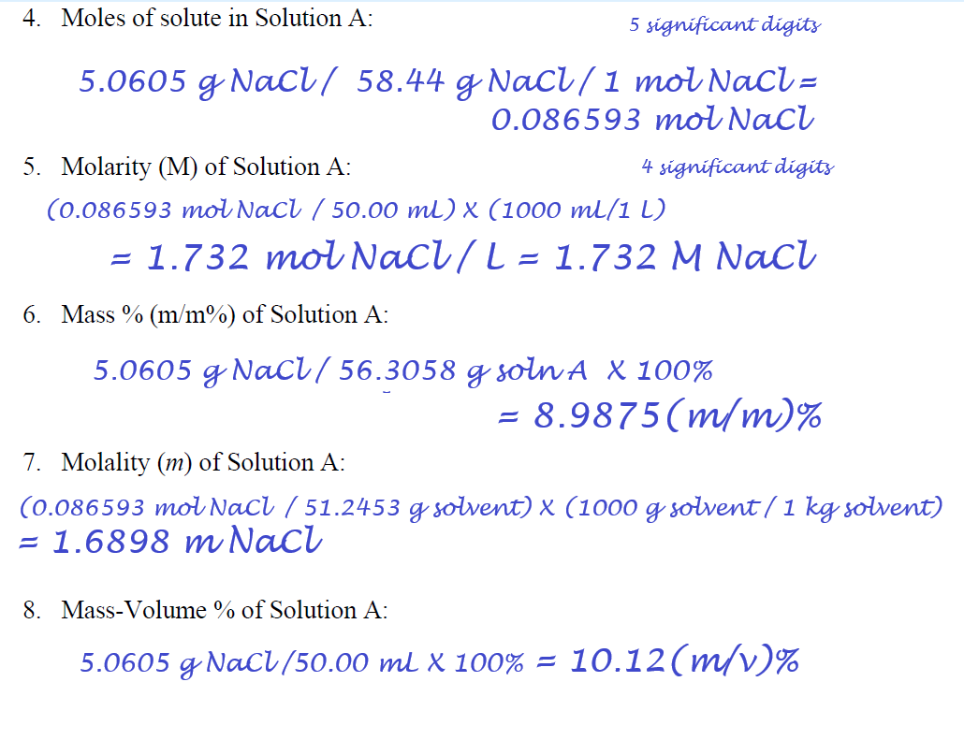
Example Data Analysis

Slide 13
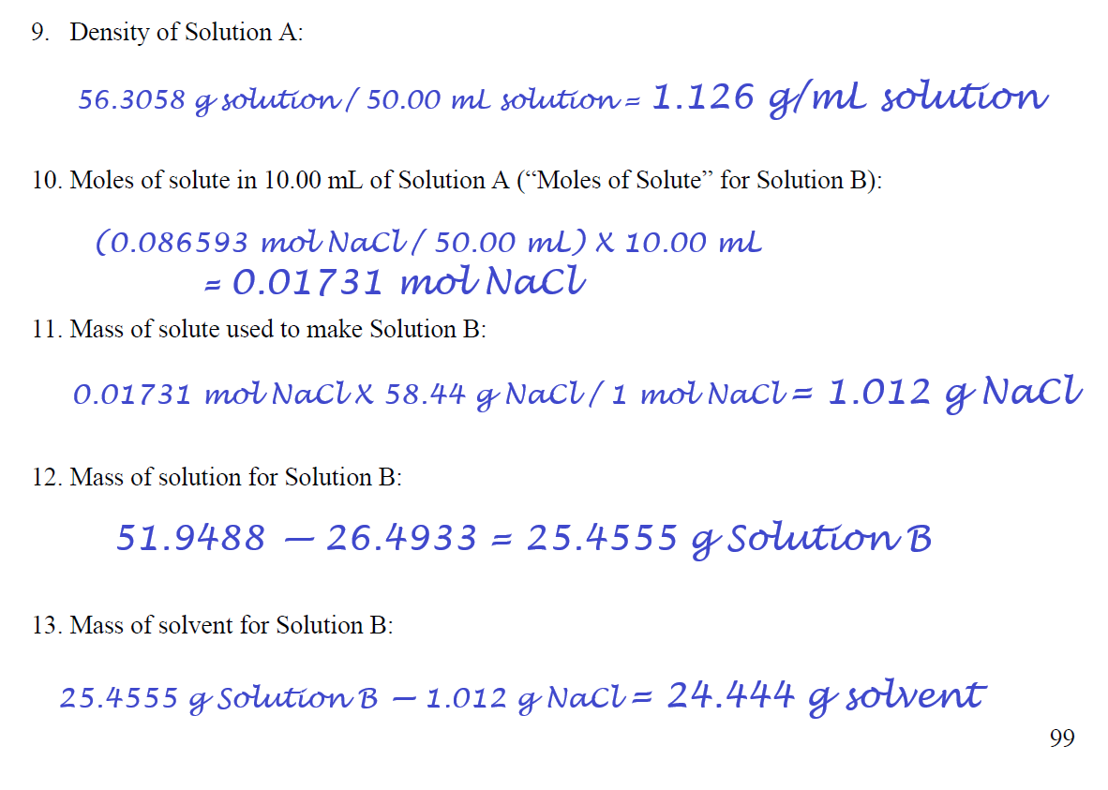
Example Data Analysis

Slide 14
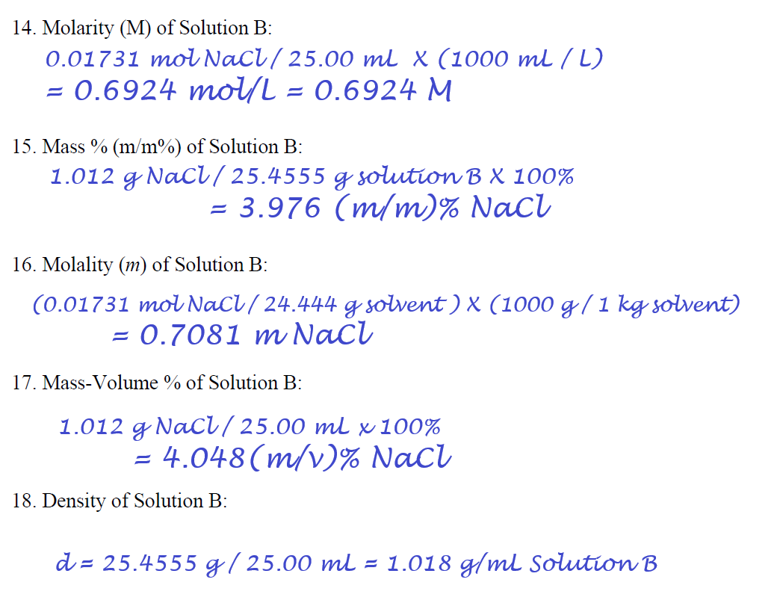
Example Data Analysis

Slide 15
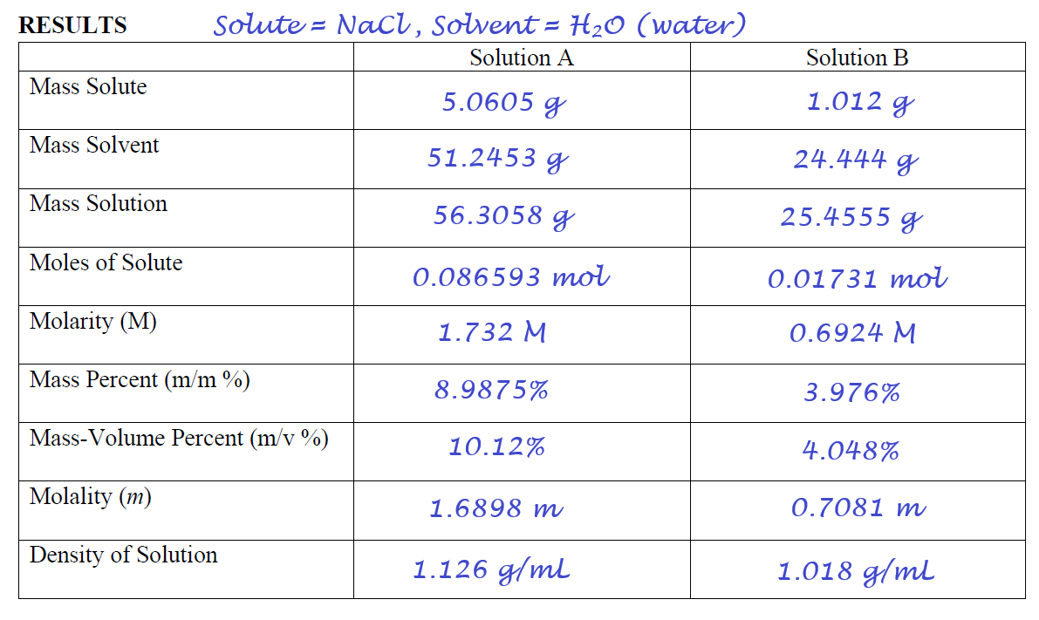
Example Data Analysis

Slide 16
Example Data Analysis
Make sure that you use the significant digits of for the volumes in the flasks and pipets shown on p 97: 10.00 mL, 25.00 mL, 50.00 mL

Slide 17
Example Data Analysis

Slide 18
Example Data Analysis

Slide 19
Example Data Analysis

Slide 20
Example Data Analysis

Slide 21
Example Data Analysis

